Slide 1
Microsoft Purview POC / Pilot Framework

Slide 2
Agenda
POC Timeline
Guiding Principles
Environment Setup
POC Architecture
POC Status, Overview, Success Criteria
Next Steps

Slide 3
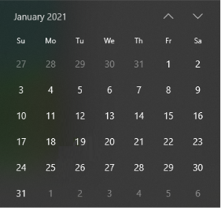
Purview POC Milestones, Timeline, & Status
We have a “framework” in place, and we are getting into specific recommendations…
Review Current State
(High Level)
Create/ Review Framework
POC Execution
Review and Prioritize Recommendations
Stakeholder Communication/ Presentations
Governance Current State Discovery
POC Criteria Alignment
POC Environment Setup
POC Criteria Alignment cont.
Identify Source Systems & Data Sets for POC
POC Execution
Key Decisions
Future State Architecture Recommendations
Demonstrations / Feedback loop
Today

Slide 4
Key Guiding Principles and Goals
Confirm the feasibility of implementing Purview by testing functionalities and cataloging a selection of key data assets through a Proof of Concept.
Decreasing time to discover data through self-service options for various skill groups.
Establishing key scenarios & user groups for testing functionalities including:
Catalog business-critical assets
Import definitions of data elements to build business glossary
Discover business-critical assets by searching business/technical terms
Track data to understand its origin and troubleshoot data issues
Enrich metadata on critical data assets with classification and labelling.
Support plan for a smooth transition from POC to production.
Business case readout including a TCO for Microsoft Purview.
Purview quotas and limitations listed here
Notes:
owais

Slide 5
Environment Setup & POC Preparation
Quickstart: Create a Purview account in the Azure portal - Azure Purview | Microsoft Docs
Quickstart: Create a collection - Azure Purview | Microsoft Docs
Tutorial: Register and scan an on-premises SQL Server - Azure Purview | Microsoft Docs
Create and manage credentials for scans - Azure Purview | Microsoft Docs
Quickstart: Create a collection - Azure Purview | Microsoft Docs
Data Catalog lineage user guide - Azure Purview | Microsoft Docs
Create a scan rule set - Azure Purview | Microsoft Docs
GitHub - tayganr/purviewlab
Notes:
Ann

Slide 6
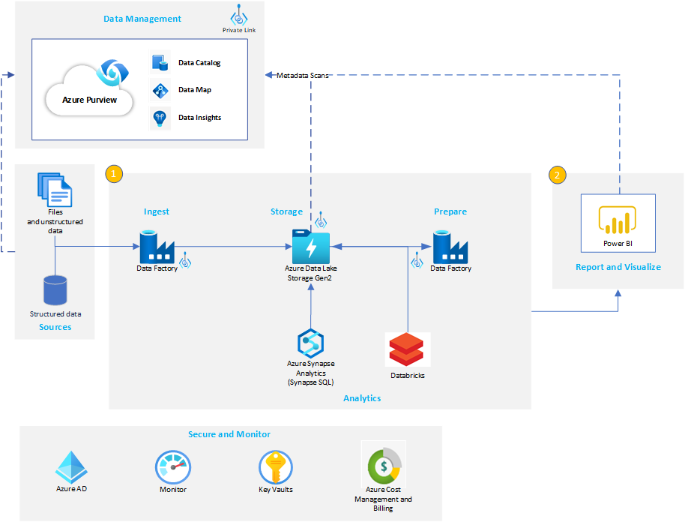
POC High Level Architecture
SAMPLE
Notes:
Visio File here to Modify based on customer requirements : https://arch-center.azureedge.net/data-lake-purview.vsdx

Slide 7
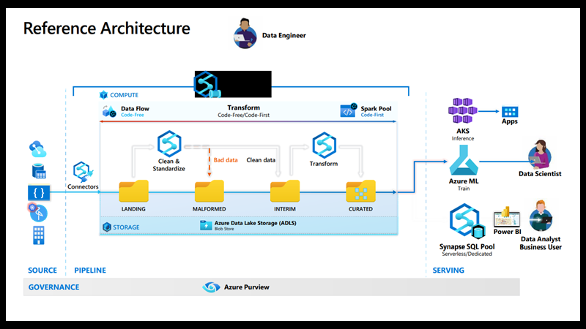
POC High Level Architecture
SAMPLE
Notes:
Visio File here to Modify based on customer requirements : https://arch-center.azureedge.net/data-lake-purview.vsdx

Slide 8
Source System Identification
SAMPLE
Category​ | Source System | Number of Entities | Scan Frequency
On Prem | SQL Server
 | Teradata
 | Oracle
 | Hadoop - Hive Meta Store
 | SAP ECC
 | SAP S4HANA
Azure | ADLS Gen2
 | ADLS Gen1
 | Azure Storage
 | Azure SQL DB/MI
 | Azure Synapse Dedicated Pool
 | Azure Data Explorer
 | Azure Cosmos DB
 | Power BI
Multi-Cloud | AWS S3
 | AWS Redshift
 | GCP Big Query
 | GCP Cloud Storage
 | Looker
 | Tableau
List of supported sources here : https://docs.microsoft.com/en-us/azure/purview/azure-purview-connector-overview
Notes:
Owais
Purview deployment checklist : https://docs.microsoft.com/en-us/azure/purview/tutorial-azure-purview-checklist

Slide 9
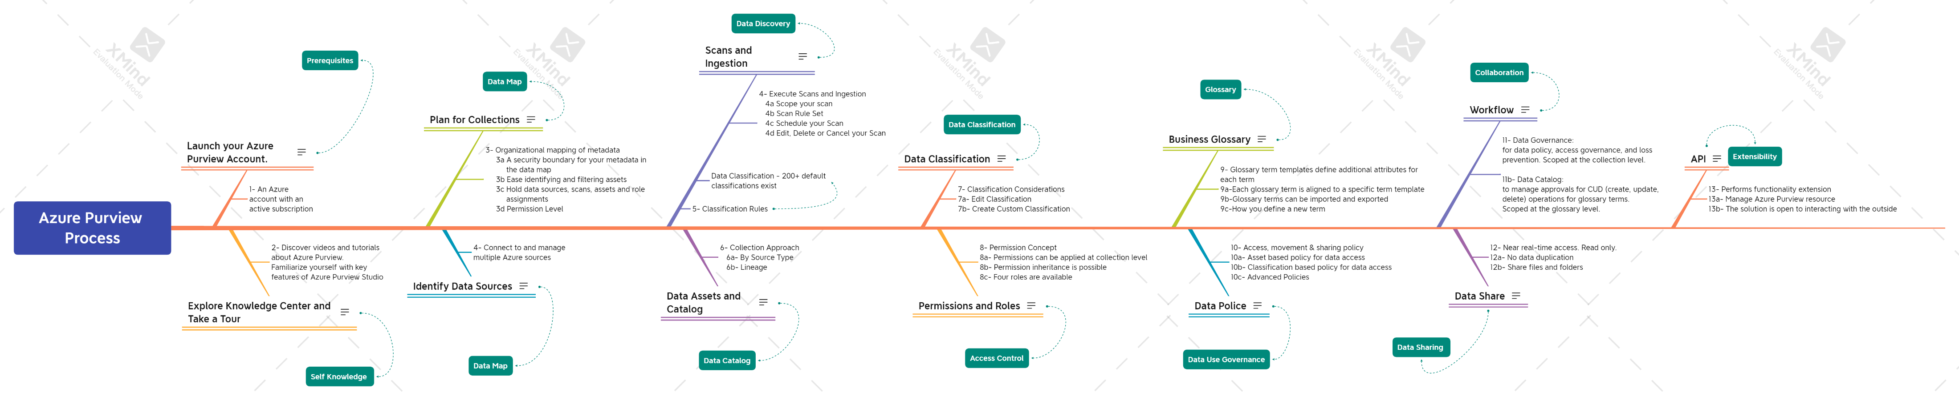
Azure Purview Process from Data Governance Point of view

Slide 10
POC framework approach example
Category​ | Capability | Success Criteria
Source System Scanning | Register System | Demo Functionality in Purview
 | Scan Source System | Demo Functionality in Purview
 | Schedule System Scan | Demo Functionality in Purview
 |  | Demo Functionality in Purview
Data Democratization | Create Data Map | Demo Functionality in Purview
Data Democratization | Search Data Catalog | Demo Functionality in Purview
Data Democratization | Search Glossary from Purview | Demo Functionality in Purview
 | Show Data Linage From Purview | Demo Functionality in Purview
 | Enrich metadata on scanned entity | Demo Functionality in Purview
 | Show PowerBI from Purview | Demo Functionality in Purview
Security | Access Control from AD | Demo Functionality in Purview
 | Automated Sensitivity Classification | Demo Functionality in Purview
 | Manual Update Sensitivity Classification | Demo Functionality in Purview
 |  | Demo Functionality in Purview
Misc. | Reporting on Scan Success and Failure | Demo Functionality in Purview
 | Reporting on Data Sensitivity | Demo Functionality in Purview
 |  | Demo Functionality in Purview
Notes:
Ann

Slide 11
POC framework approach example
Area | Description | Assumptions
(Sprint 0) | Mutually agreed scope and create a product backlog. Define product backlog items to develop a clear understanding of the as-is situation and capture key insights that can inform decision making for the design of the future Data Governance operating model. Define POC scope and scenarios product backlog items which may include: Discover business-critical assets Catalog business-critical assets Track data to understand its origin and troubleshoot data issues. Enrich metadata on critical data assets Govern data assets with friendly user experience Define acceptance criteria | 2-week effort – Conduct interviews and working sessions with customer’s data governance and management strategy owner and SME’s Define the acceptance criteria for the POC MSFT has access to customer documentation and key resources
Data Purview Infrastructure Workstream | POC will be delivered through 3-week sprint intervals, and may include the following tasks: Configure ADF for lineage Import glossary terms Get classification and sensitive insights Onboard additional users using Purview managed users Scan Azure Data Lake Gen 2 storage as data source Scan Azure Synapse as data source Scan Power BI tenant as data source Search and browse Platform enablement | At the end of each sprint the customer Project Manager and Microsoft Project Manager will review the consumption against the total capped capacity to determine if adjustments need to be made through the change request process. Customer has the required Azure Subscriptions and services available. There will be maximum of 4 hands on purview labs each having maximum of 2 hours duration Access to Microsoft Azure with a development or production subscription Ability to create Azure resources including Purview. Access to data sources such as Azure Data Lake Storage or Azure Synapse in test, development, or production environments For Data Lake Storage, the required role to scan is Reader Role. For Synapse, the identity must be Purview Data Source Admin and Synapse Workspace Contributor. For PBI, the Purview managed identity needs read-only access to the Power BI admin APIs. Access to Azure Security Center or ability to collaborate with Security Center Admin for data labeling.
Notes:
Acronyms
SSAS: SQL Server Analysis Services
SSIS: SQL Server Integration Services

Slide 12
POC framework approach example
Area | Description | Assumptions
Data Governance Workstream | Data Governance will be delivered through 3-week sprint intervals, and may include the following tasks: Define data governance attributes for desired future state. Align Data Governance Strategy messaging with other initiatives or transformations to verify alignment and eliminate conflicts. Identify stakeholders and conduct a stakeholder impact assessment. Establish a data governance and management approach, which may include the following components – data access, data certification, anonymization, normalization, data lineage (where is come from, certified data, heritage), data definitions (what it represents, metrics and measurements included to define the datasets), business rules how data set is used, data cost management Data Catalogue Based on data governance rules, how's data presented for consumption Data Security Operations Management - Azure specific data access rules, management groups, data access monitoring Managing cloud data environment and RBAC controls Azure Data Blueprint (Initiative, Policies, RBAC) templates Data Operations and Lifecycle Management Data visualization Operations and Governance Determine required data operations roles and responsibilities. | At the end of each sprint the customer Project Manager and Microsoft Project Manager will review the consumption against the total capped capacity to determine if adjustments need to be made through the change request process.
Notes:
Acronyms
SSAS: SQL Server Analysis Services
SSIS: SQL Server Integration Services

Slide 13
POC Criteria & Success Criteria
Category​ | Capability | Success Criteria
Source System Scanning | Register System | Demo Functionality in Purview
 | Scan Source System | Demo Functionality in Purview
 | Schedule System Scan | Demo Functionality in Purview
 |  | Demo Functionality in Purview
Data Democratization | Create Data Map | Demo Functionality in Purview
Data Democratization | Search Data Catalog from Synapse | Demo Functionality in Synapse
Data Democratization | Search Glossary from Purview | Demo Functionality in Purview
 | Show Data Linage From Purview | Demo Functionality in Purview
 | Enrich metadata on scanned entity | Demo Functionality in Purview
 | Create PowerBI Report from Purview | Demo Functionality in Purview
Security | Access Control from AD | Demo Functionality in Purview
 | Automated Sensitivity Classification | Demo Functionality in Purview
 | Manual Update Sensitivity Classification | Demo Functionality in Purview
 |  | Demo Functionality in Purview
Misc. | Reporting on Scan Success and Failure | Demo Functionality in Purview
 | Reporting on Data Sensitivity | Demo Functionality in Purview
 |  | Demo Functionality in Purview
Notes:
Owais

Slide 14
Appendix
POC Assets : Azure Purview Assets - OneDrive (sharepoint.com)

Slide 15
Thank you

